Slide 1
Alameda Open Space Solar Covered Parking
CITY OF ALBUQUERQUE EPC HEARING
SEPTEMBER 15TH, 2022

Slide 2
A collaborative project of the City of Albuquerque, Bernalillo County and the Water Authority to:
Improve parking at Alameda Open Space
Save energy
Preserve our natural resources
Provide educational opportunities

Slide 3
Composite Site Plan -
Total production of all canopies is enough to power 233 average American homes for one year.
City of Albuquerque Property
City of Albuquerque & Bernalillo County Property
Bernalillo County Property

Slide 4
Project Benefits
Provide shade for cars and people on hot summer days
Provide cover from rain and snow
Save energy long-term and lower costs
Offset about 36% of raw water pump station electric usage
Provide opportunities for education
Preserve natural resources
Provide 2 electric vehicle charging stations

Slide 5
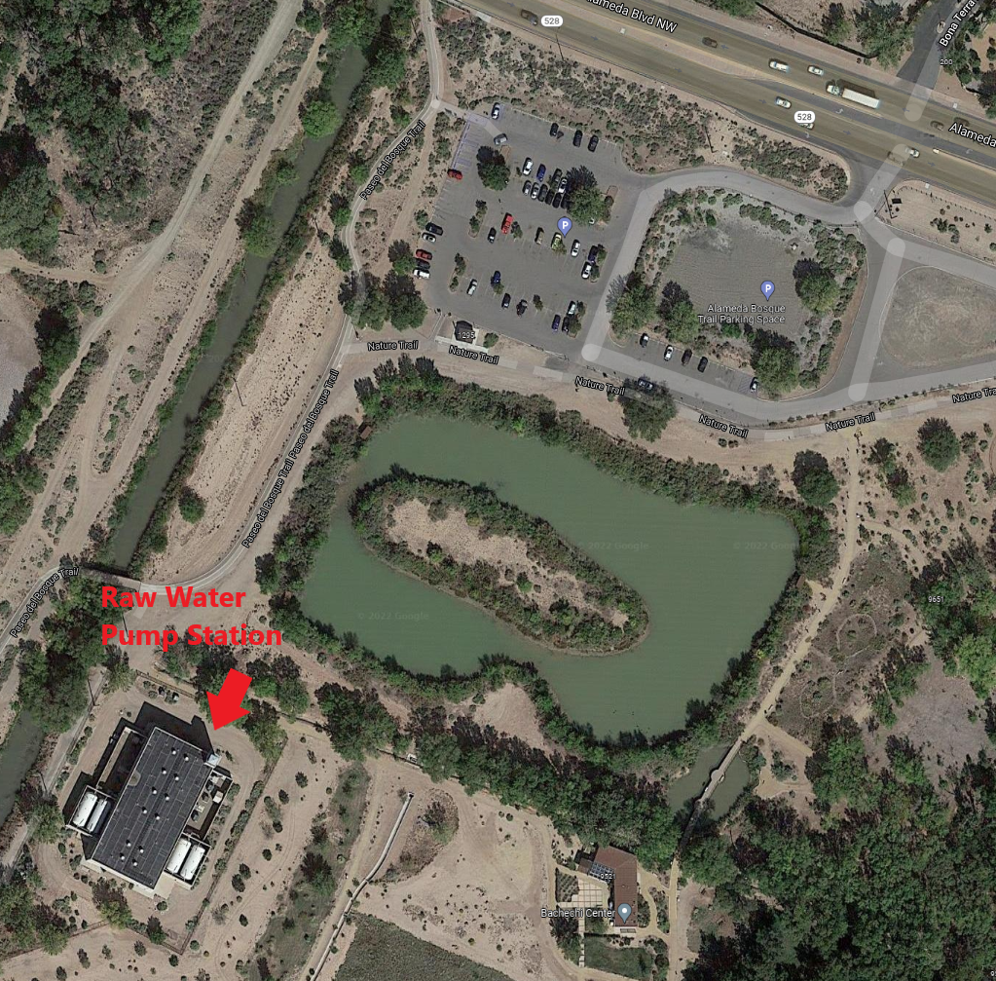
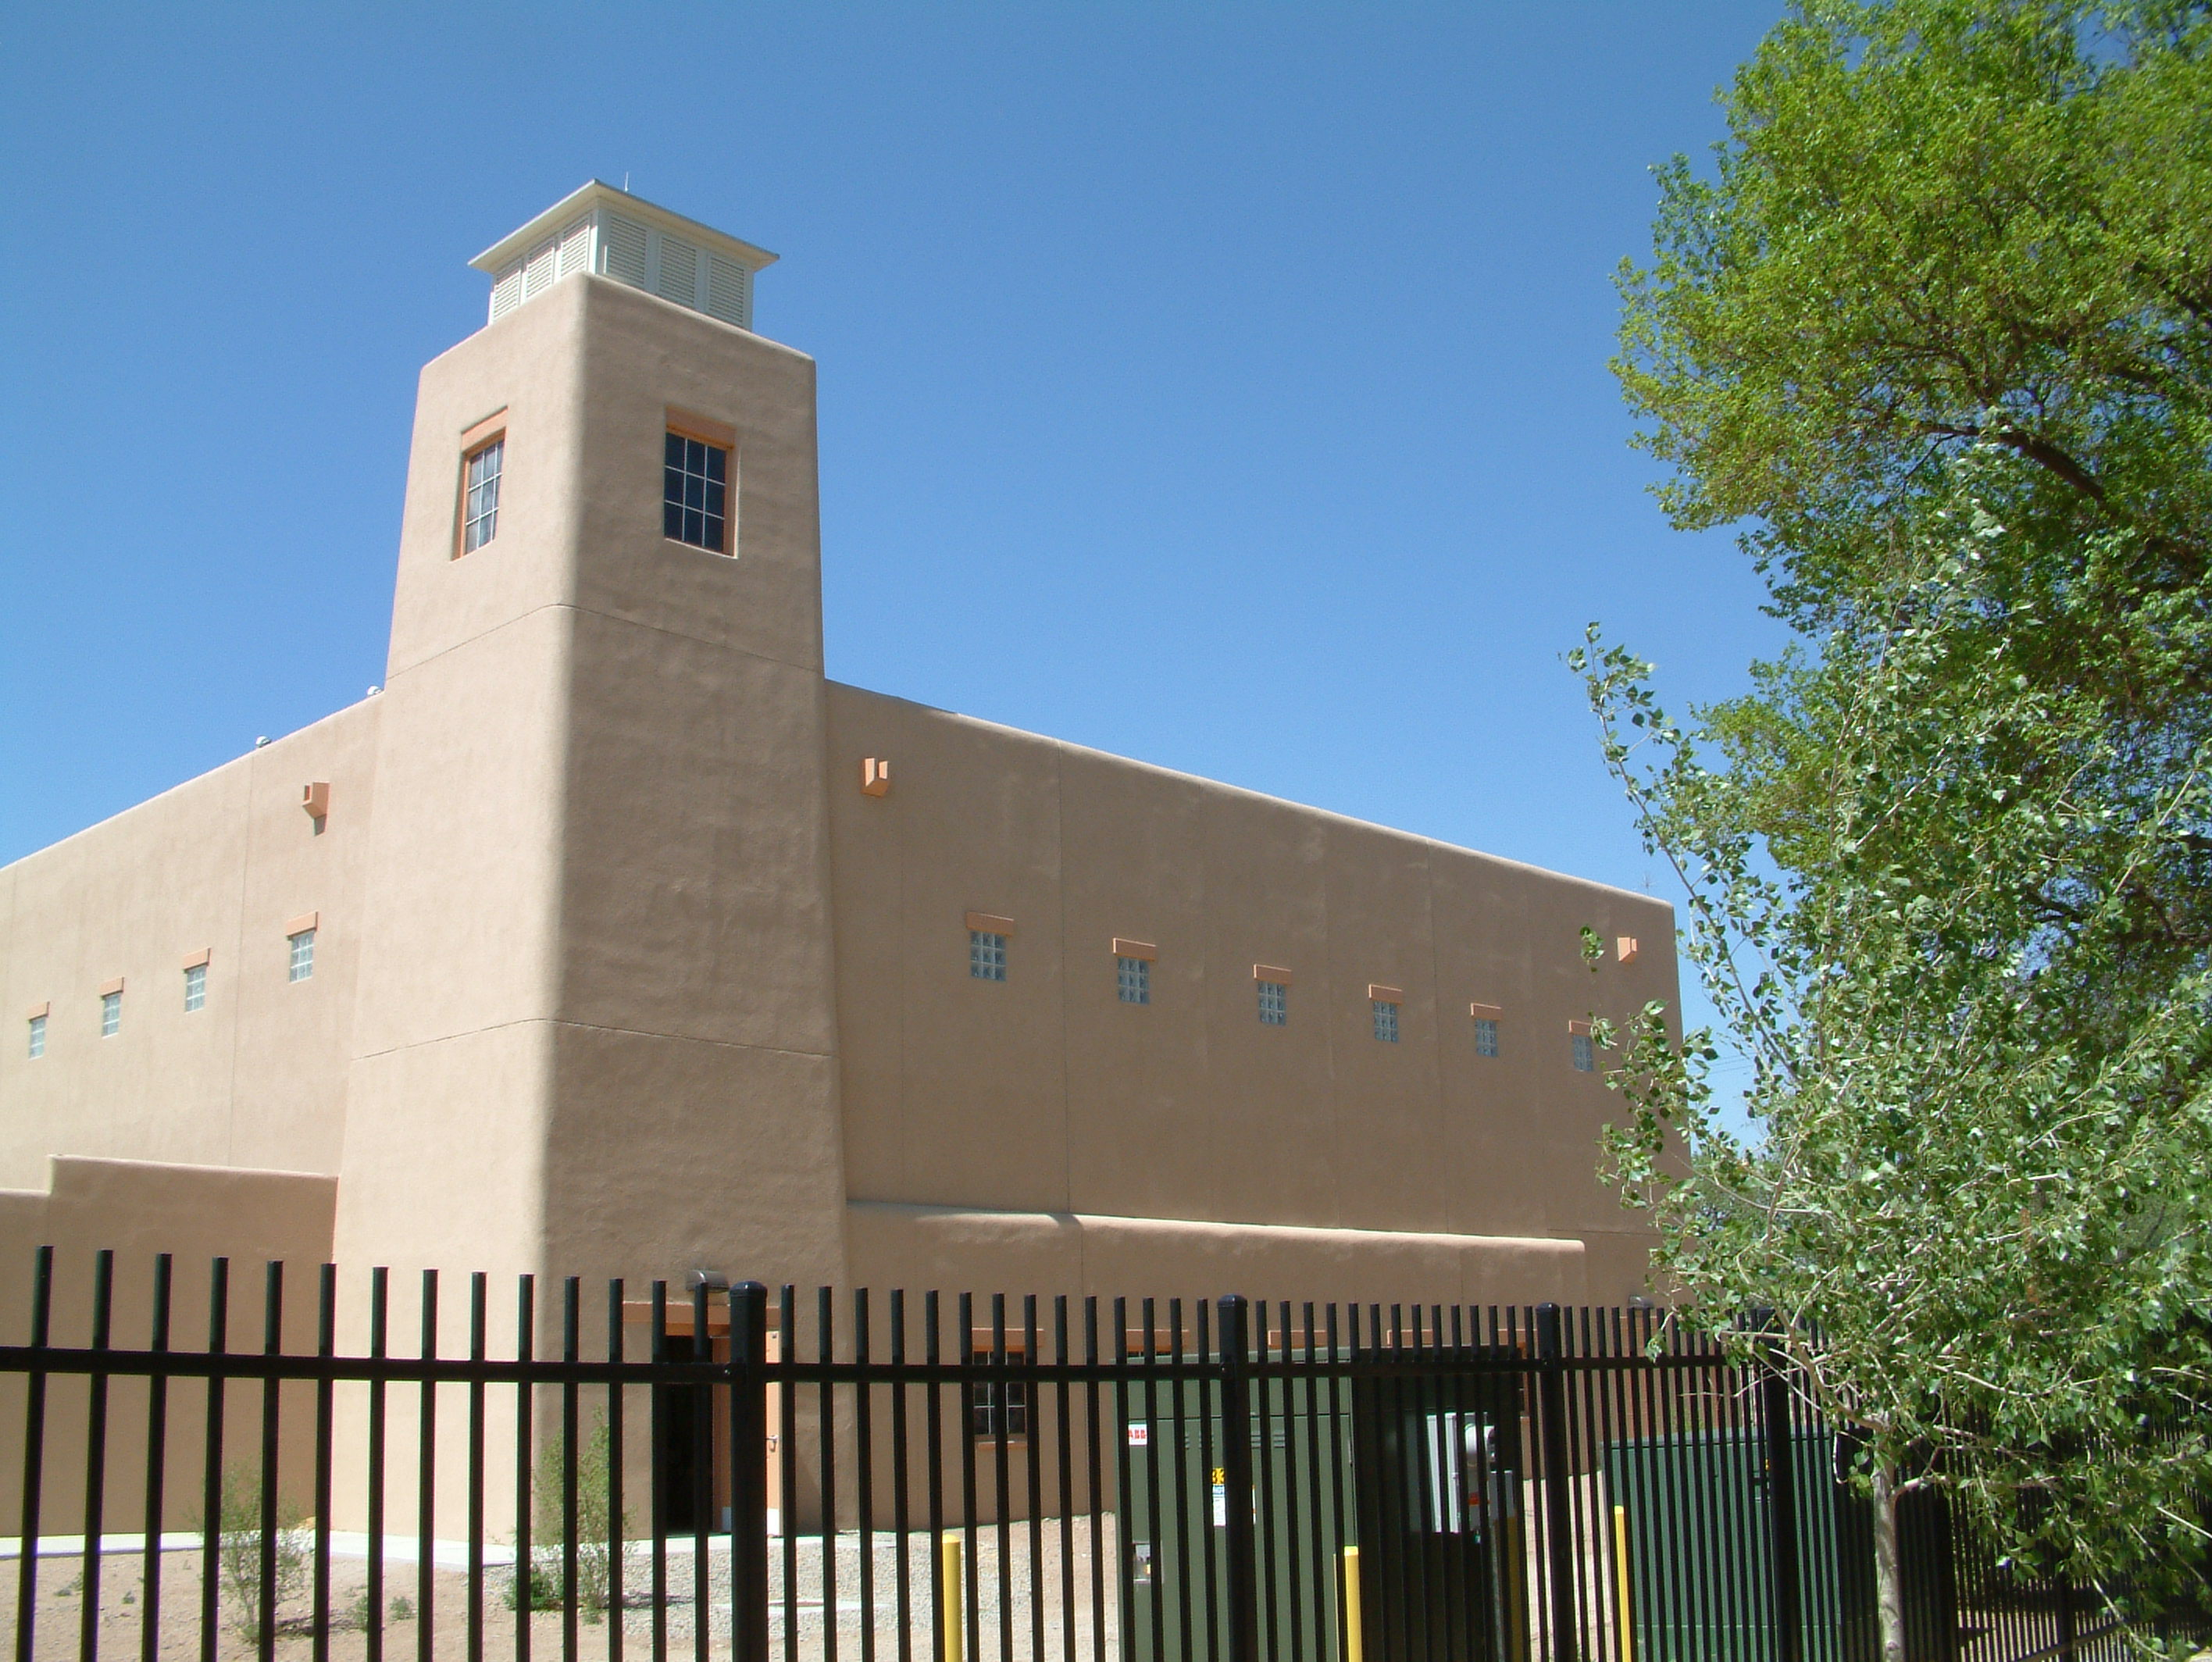
Raw Water Pump Station
Draws water from the Rio Grande
and pumps it to the San Juan-Chama
Drinking Water Project to be treated
and used as drinking water.
Is located close to
Alameda Open Space
parking

Slide 6
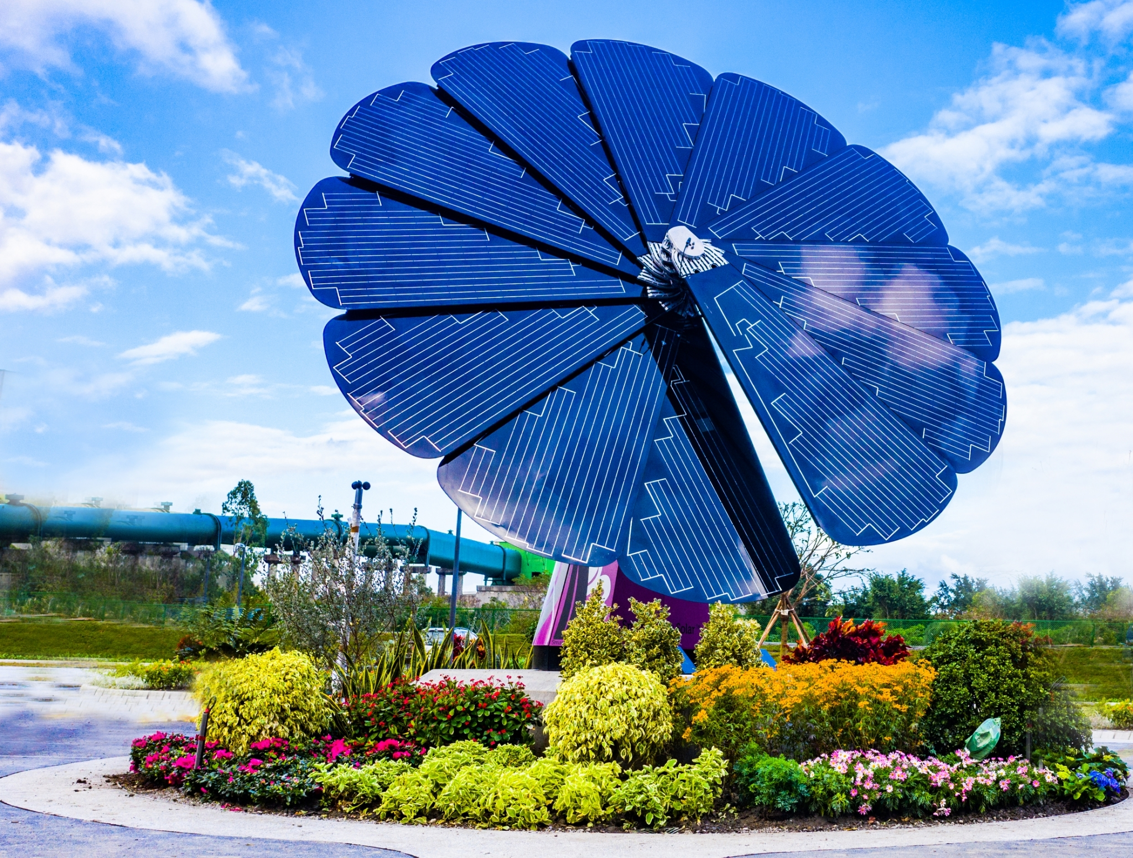
Provide On-Site Education through SmartFlower Solar Flower

Slide 7
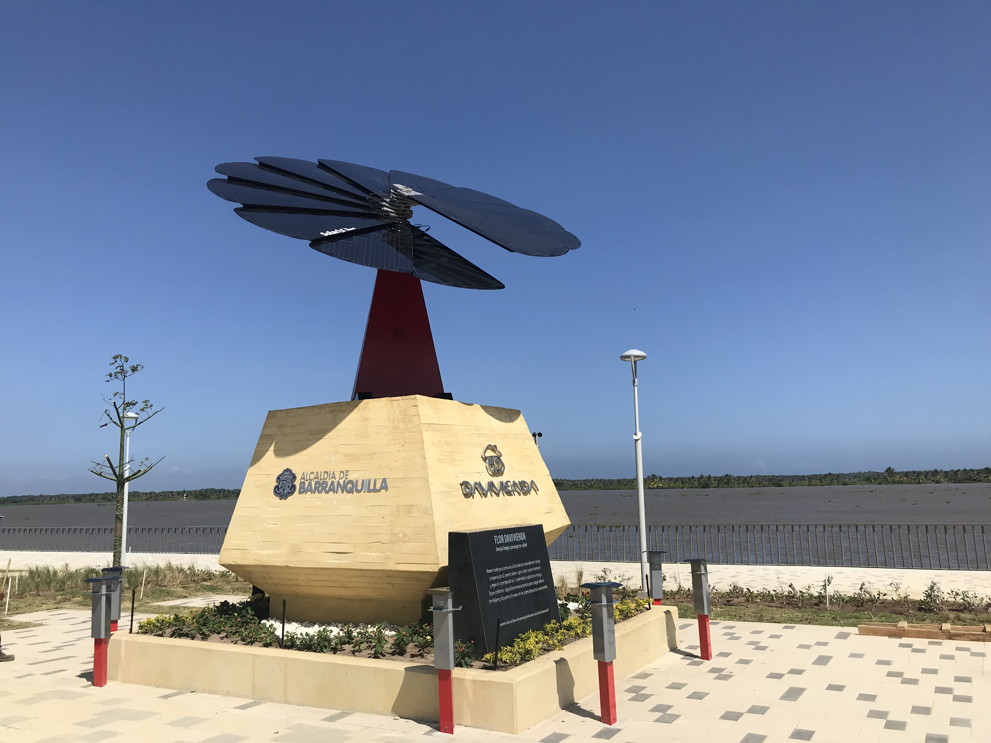
The SmartFlower Solar Flower
Ground-mounted dual access tracker solar array produces up to 40% more energy than single axis solar arrays
Students and adults can learn about how solar energy is produced through various solar energy technologies
Also, they can learn how the SmartFlower is able to follow the sun and knows when to retract and deploy automatically.

Slide 8
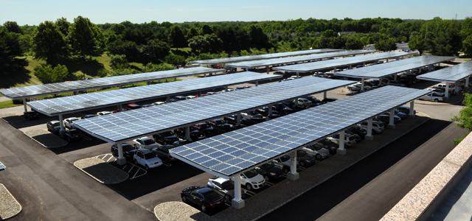
Solar Covered Parking Will Provide Open Drive Lane

Slide 9
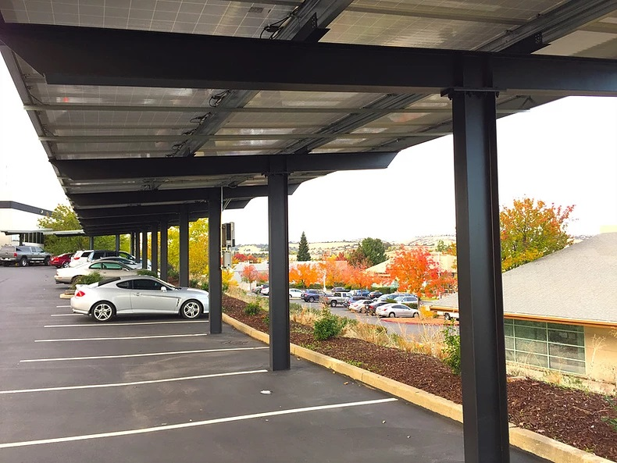
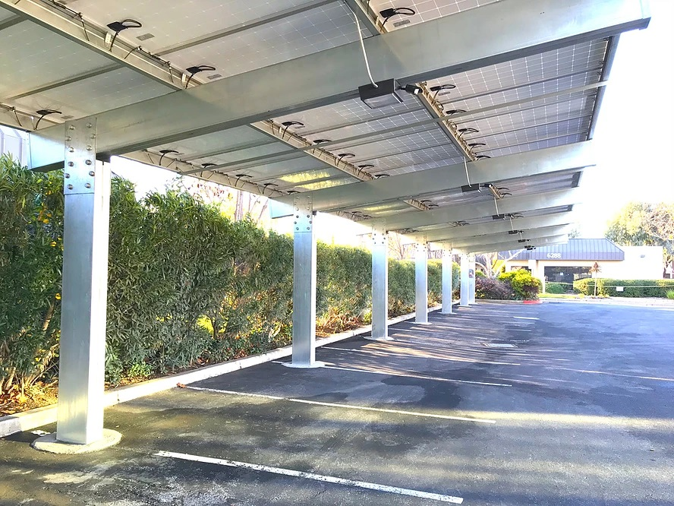
Photos of Single-Row Cantilever Canopies

Slide 10
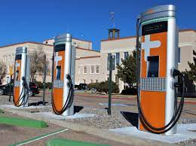
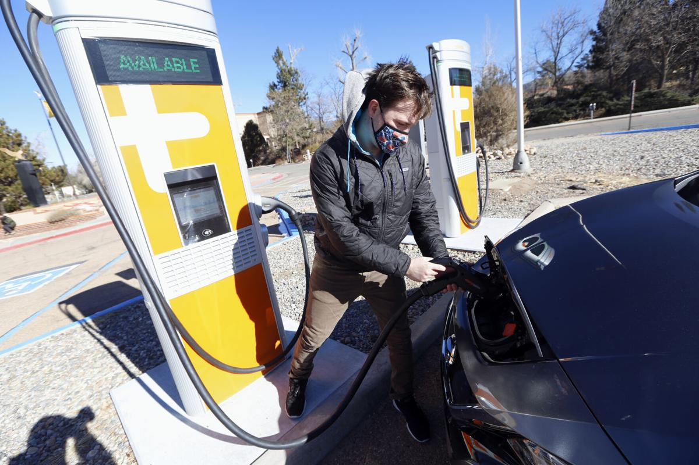
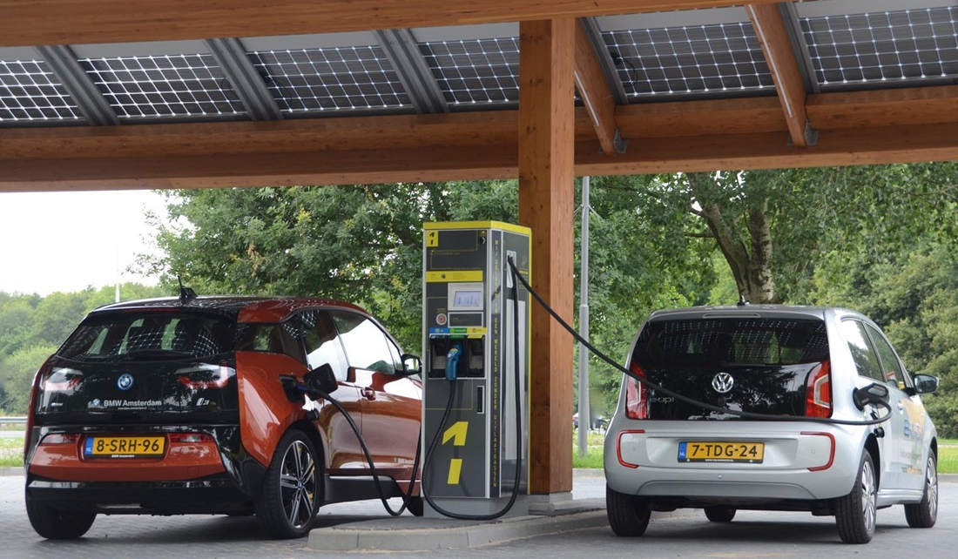
Examples of Electric Vehicle Charging Stations

Slide 11
Current Construction Plans and Timeline
Construction is currently planned for fall/winter 2022 to minimize impact.
Walking, bike and equestrian trails will remain open.

Slide 12
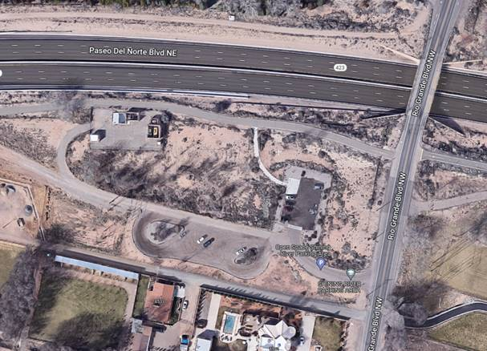
Current Construction Plans and Timeline (continued)
Parking during construction will be open in the Shining River parking area.
Construction is expected to
last about 4-6 (four to six)
months.

Slide 13
Questions?

